Slide 3
Which of the following is true about the ACT?
(A) The ACT measures with certainty how well you will do in life. It perfectly predicts your ability to succeed in high school and college classes as well as your activities outside the classroom.
(B) The “A” in ACT stands for Aptitude because it measures your “intellectual aptitude” otherwise known as your intelligence.
(C) The “A” in ACT stands for “Achievement” because it measures how much you have “achieved” or learned during your life as a student to this point.
(D) The ACT tests your knowledge of the ACT.

Slide 4
What’s the point of the ACT?
THE ACT exam is what colleges use to compare students from different regions, schools, etc…
THE ACT is HOW you VALIDATE your grades!
Some colleges use ACT “College Readiness Benchmarks”

Slide 5
Introduction to the ACT

Slide 6
Get
Ready
To
Rumble

Slide 7
Setting Goals
Know what you’re getting yourself into before you start
Saying to yourself, “I want to do well on the ACT” is RECIPE FOR FAILURE!
Instead, define what “Well” means for YOU!

Slide 8
ACT PREP GOALS
The ACT Prep Goals Worksheet hopefully allows you to go through the following progression
What schools do I want to go to?
What ACT scores do those schools typically require?
How many questions do I need to answer correctly in each section?
These are specific goals that you can actually reach!

Slide 9
ACT PREP GOALS
University of Colorado
Average ACT Composite = 25
Math, Reading, English, Science
Math Raw = 40, Reading Raw = 27

Slide 10
Scaled Score | English (75 questions) | Math (60 questions) | Reading (40 questions) | Science (40 questions)
36 | 75 | 60 | 40 | 40
35 | 73-74 | 59 | 39 | 39
34 | 71-72 | 58 | 38 | -
33 | 70 | 56-57 | 37 | 38
32 | 69 | 55 | 36 | 37
31 | 67-68 | 54 | 35 | -
30 | 66 | 52-53 | 34 | 36
29 | 65 | 50-51 | 32-33 | 35
28 | 63-64 | 48-49 | 31 | 33-34
27 | 62 | 45-47 | 30 | 32
26 | 60-61 | 42-44 | 29 | 30-31
25 | 58-59 | 40-41 | 27-28 | 28-29
24 | 56-57 | 37-39 | 26 | 26-27
23 | 54-55 | 35-36 | 24-25 | 25
22 | 52-53 | 33-34 | 23 | 23-24
21 | 49-51 | 31-32 | 22 | 21-22
20 | 46-48 | 29-30 | 20-21 | 19-20
19 | 43-45 | 26-28 | 19 | 18
18 | 41-42 | 24-25 | 18 | 16-17
17 | 39-40 | 21-23 | 16-17 | 15
16 | 36-38 | 17-20 | 15 | 14
15 | 33-35 | 14-16 | 14 | 13
14 | 30-32 | 11-13 | 12-13 | 12
13 | 28-29 | 9-10 | 11 | 11
12 | 26-27 | 7-8 | 9-10 | 10
11 | 24-25 | 6 | 8 | 9
10 | 22-23 | 5 | 6-7 | 7-8
9 | 20-21 | 4 | - | 6
8 | 17-19 | 3 | 5 | 5
7 | 14-16 | - | 4 | 4
6 | 11-13 | 2 | 3 | 3
5 | 8-10 | - | - | -
Average ACT scores are only slightly better than 50% correct!

Slide 11
How is the ACT Scored?
The ACT is not scored in the same way that most tests.
For every question you answer correctly you will receive 1 raw point.
There is NO PENALTY for answering questions incorrectly.
NEVER LEAVE ACT QUESTIONS BLANK!

Slide 12
How is the ACT scored?
Each subject area of the test, math, reading and writing, is scored on a scale between 1 and 36.
The four sub-scores are then averaged for a total score of between 1 and 36.
The ACT is graded on a curve and each section is scaled so that the average score is approximately 21.

Slide 13
Converting Scaled Scores to # Correct
Raw= (# correct)
No Guessing Penalty
40 Math Raw= 40 correct out of 60
40/60= 67% or D in HS Class

Slide 14
Setting Specific Goals
Look for the “scaled score” that correspond to your chosen colleges
Note the corresponding “raw” score
On the ACT….raw score simply means # correct

Slide 15
How is the ACT Scored?
For every question you answer correctly you will receive 1 raw point.
There is NO PENALTY for answering questions incorrectly.
NEVER LEAVE ACT QUESTIONS BLANK!

Slide 16
Scaled vs. Raw Scores
Raw scores are what you want to worry about
Scaled scores are the scores out 36 that colleges will look at
Once you figure out what scaled scores you will need to reach your goals, then you’ll be able to see what raw score you’ll need to get there!

Slide 17
Section I: ACT Basics

Slide 18
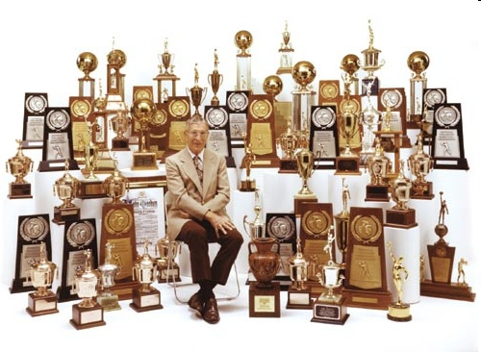
ACT Introduction:
“Failing to prepare is preparing to fail.”
-John Wooden
Before we can succeed on the ACT, we need to understand what will be tested and how the questions will be asked.

Slide 19
What on the ACT?
ACT Questions include:
Math -(Algebra, Geometry, Fundamentals)
Reading -(Reading Comprehension)
English -(Grammar, Usage, Rhetoric, Mechanics)
Science-(Data Analysis, Interpretation, Reasoning, Problem-Solving)

Slide 20
Who writes the ACT?
You may think that a bunch of college presidents get together each year to write the ACT
Just because they are the ones who use the test doesn’t mean that they write it!
The ACT is written by ACT Inc, who also write many other standardized tests, such as the EXPLORE, PLAN, and COMPASS Test

Slide 21
When is the Test Offered?
The 2011-2012 test dates and registration deadlines can be found by visiting ACT’s website
ACT Exams Offered in…
September
October
December
February
April
June

Slide 22
Section II: The Four ACT Tests

Slide 23
Section | # Questions | Time | Average Score
English | 75 | 45 | 20.6
Math | 60 | 60 | 21.0
Reading | 40 | 35 | 21.4
Science | 40 | 35 | 20.9
Optional Writing Test | 1 essay | 30 | 7.7

Slide 24
English Test
45 Min for 75 Questions
5 essays on the left side of the page, words/phrases underlined
These questions will test you on grammar, punctuation, structure, rhetoric, as well as style and organization

Slide 25
Math Test
60 Minutes for 60 Questions
Not exactly in order of difficulty, but easy questions tend to come at the beginning and hard questions tend to come at the end
Questions include pre-algebra, algebra, plane/coordinate geometry, and a little bit of trig

Slide 26
Reading Test
35 Min for 40 Questions
4 Total Passages
Prose Fiction: #1-10
Social Science: #11-20
Humanities: #21-30
Natural Science: #31-40
Each Passage will have 10 questions

Slide 27
Science Test
35 Min for 40 Questions
No specific science knowledge required
7 total passages, which will test your ability to interpret graphs, charts, experiments, etc…
*DATA REPRESENTATION (3)
RESEARCH SUMMARIES (3)
CONFLICTING VIEWPOINTS (1)

Slide 28
Writing Test (“Optional”)
One Prompt, 30 Minutes
You will be asked for your opinion
Two graders score from 1-6 each, total out of 12

Slide 29
Section III: Test-Taking Tips

Slide 30
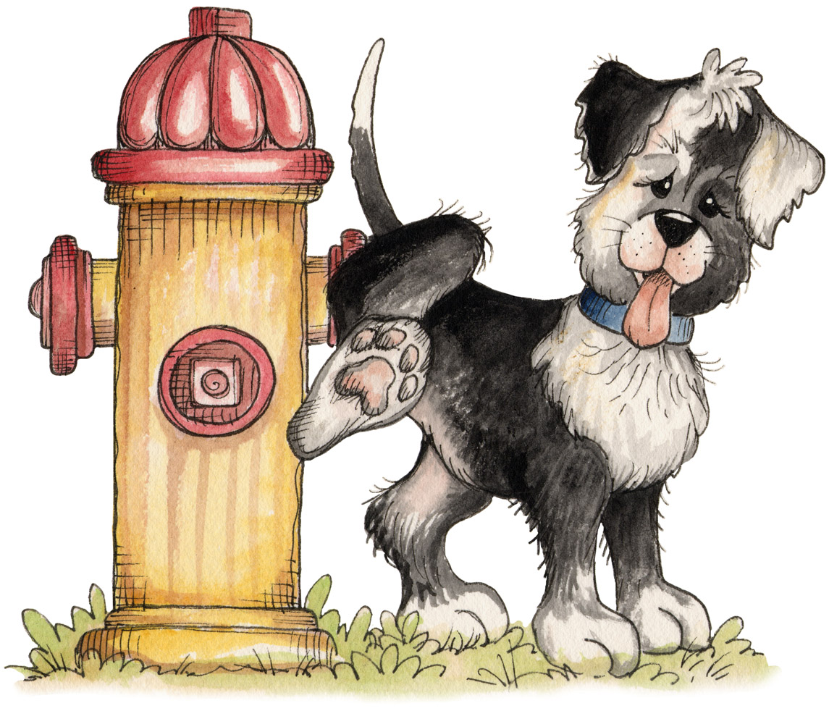
The Test Booklet:

Slide 31
Process of Elimination:
Every multiple choice question on the ACT has three or four wrong answers and only one correct answer.
By looking for the wrong answers instead of the correct ones, you will often be left with just a few answer choices to make an educated guess from.

Slide 32
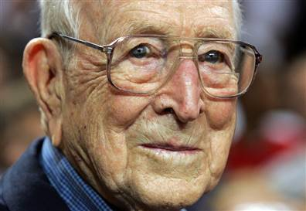
Be Quick But Don’t Hurry
On the ACT, every question is worth the same amount.
How does this help you?
Don’t spend too much time on any one question
Don’t rush through problems that you know how to do

Slide 33
Here’s an Example:
What is the capital of North Dakota?
A. Billings
B. Dallas
C. Bismarck
D. Fargo

Slide 34
Section III: Outsmarting The ACT

Slide 35
Order of Difficulty?
ACT questions DO NOT follow a specific order of difficulty
In general, easy math questions come at the beginning
In science and reading, the more difficult passages tend to come at the end
WE WANT TO FIND/ANSWER EASY QUESTIONS FIRST!

Slide 36
Easy vs. Medium vs. Hard
Imagine it’s your job to write ACT questions…
Think about the goal of each category of question (easy, medium, difficult)
Think about the type of student that is supposed to get easy questions correct vs. the type of student who is supposed to get hard questions correct

Slide 37
What type of student do the ACT writers want to get difficult questions correct?

Slide 38
Things to Remember
EASY questions have EASY answers…trust your hunches
MEDIUM questions have MEDIUM answers…be careful of your hunches
DIFFICULT questions have DIFFICULT answers…don’t trust your hunches

Slide 39
Here is a “Difficult” Math Question…
35. Cindy walked to work at an average speed
of 6 miles an hour and biked back along the
same route at 10 miles per hour. If her total
traveling time was 2 hours, how many miles
is it from her house to work?
(A) 6
(B) 6.25
(C) 7.5
(D) 8
(E) 10

Slide 40
Put ACT Questions in Three Categories
Do Now-you know how to do it, and it won’t take that long
Do Later-you might know how to do it, but it’s going to take some time to figure out
Do Never-you have no idea how to solve, guess and move on

Slide 41
Guessing Blindly
Occasionally, you’ll have to take a random guess
When this happens, you want to put yourself in the best possible position to succeed

Slide 42
Letter of the Day
On questions where you will be making a random guess, always choose the same letter
This will increase your chances of at least getting some of these questions correct
Only use this strategy when you cannot use POE to eliminate any answers

